Slide 1
Cobot Cleaners
Exploring a new business model

Slide 2
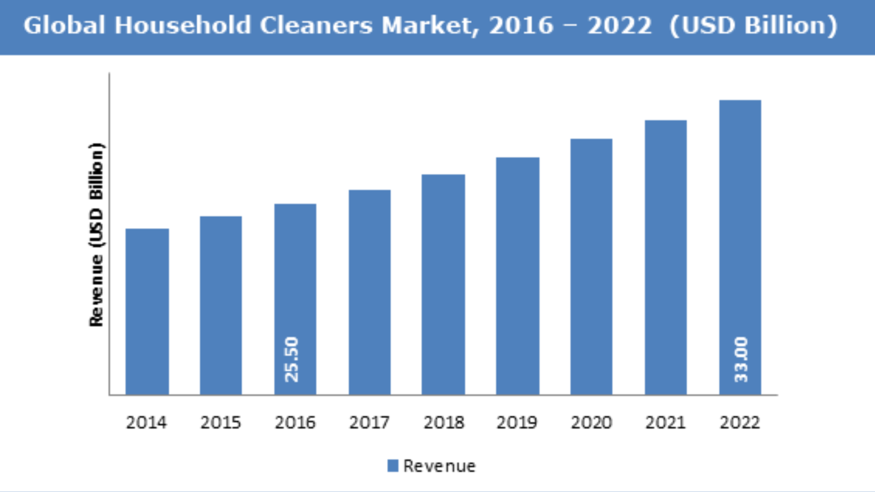
Introduction
Household cleaning is a global $33 Billion-dollar market
Collaborative robots (cobots) are becoming more common
We explore a cobot household cleaning business model for feasabiltiy
We use Operations Research techniques to determine the best way to set up the business
Notes:
Cobots: http://citeseerx.ist.psu.edu/viewdoc/summary?doi=10.1.1.37.7236
Cleaning market: https://www.zionmarketresearch.com/news/household-cleaners-market

Slide 3
Previous Work
Literature Review goes here…

Slide 4
Robot Types (resources)
We start with an investment in a mix of cleaning robots
The following table represents the robots, cost, and what we’ve invested in
A mix of each type of robot is needed to clean a location
Robot | Type | Cost | Available | Invested
1 | Vaccum | $ 400.00 | 35 | $ 14,000.00
2 | Carpet Cleaner | $ 600.00 | 25 | $ 15,000.00
3 | Sink Cleaner | $ 500.00 | 20 | $ 10,000.00
4 | Duster Drone | $ 300.00 | 30 | $ 9,000.00
5 | Window Cleaner | $ 600.00 | 35 | $ 21,000.00

Slide 5
Package Configurations
Configurations are used to clean locations with different characteristics
Package 1: 1 bath apartment or house, <= 1400 square feet with no carpet
Package 2: 1 bathroom apt or house, <= 1400 sq ft with carpet
Package 3: no carpet, 1 bathroom
Package 4: 2 bath, carpet, <= 2300 sq ft
Package 5: all carpet 2 bath <= 2000 sq ft
Package 6: carpet, 2-3 bath, <= 2000 sq ft
Column1 | Package 1 | Package 2 | Package 3 | Package 4 | Package 5 | Package 6
Robot 1 | 1 | 2 | 1 | 2 | 0 | 1
Robot 2 | 0 | 1 | 0 | 2 | 2 | 2
Robot 3 | 2 | 2 | 1 | 3 | 2 | 3
Robot 4 | 2 | 2 | 2 | 3 | 3 | 4
Robot 5 | 4 | 4 | 4 | 5 | 3 | 3
Profit | 100 | 97 | 95 | 87 | 95 | 100

Slide 6
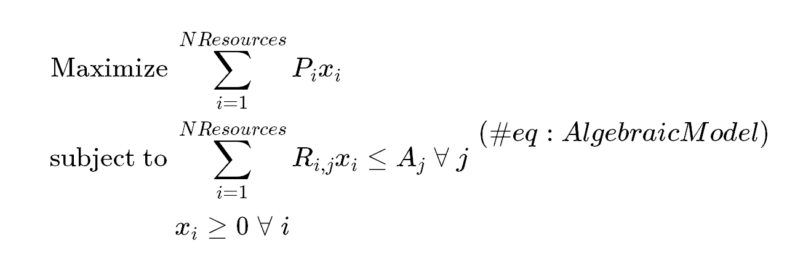
Configuration Optimization
Based on our investment and our target market, we can figure out what the most profitable robot configuration would be
Using this information we can decide which type of location or neighborhoods to focus our marketing on

Slide 7
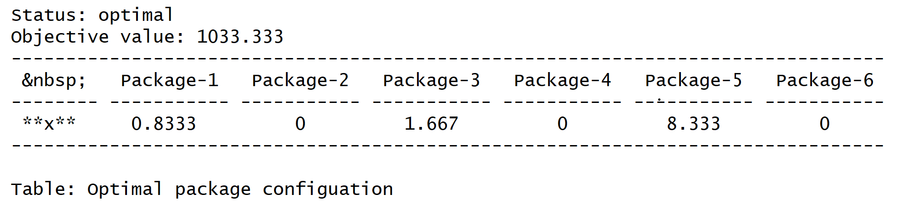
Configuration Optimization Results
Based on our results Package 5 seems to be the most profitable
We can’t clean .83 or .667 locations, so our model still needs work…

Slide 8
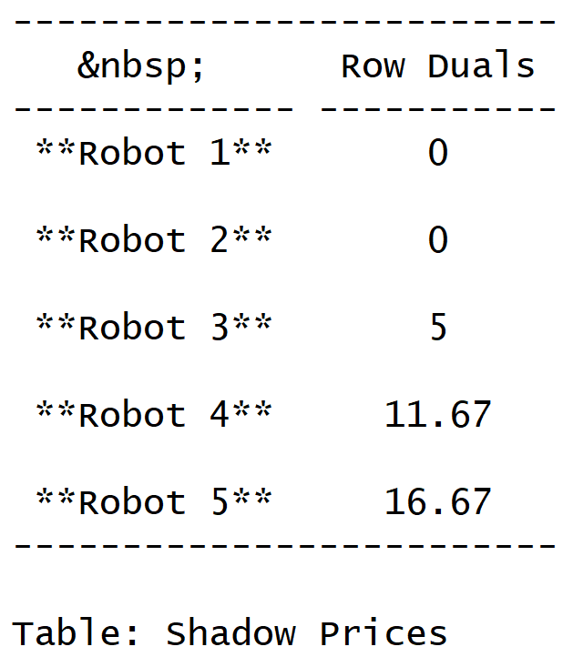
Scenario 2: Future Investment
The next thing we want to figure out is where to invest to optimize our business.
Using sensitivity analysis, we can determine what robots to invest in to maximize profitability

Slide 9
Updated Results
If we estimate what our optimal configuration would look like by adding the shadow resources to our model, we can figure out ideal projected results.

Slide 10
Scenario 3: Transportation

Slide 11
Conclusion

